Slide 1
UVW College Executive Summary
Team 8
Mohamed Mohamed - mmoham69@asu.edu
Pankaj Kumar Singh - psing109@asu.edu
Parth Bhatt - prbhatt@asu.edu
Christopher Azzara - cazzara@asu.edu
Nihar Parida - nparida@asu.edu

Slide 2
Executive Summary
Objective:
The objective of our project is to derive insights from publicly available data and identify customer segments, which can be targeted for certain campaign. Here we have used the visualization techniques that we learned from the Data Visualization subject to understand the data distributions and identify patterns to achieve our objective.
The analysis and visualization will provide vital information to plan on building ad campaigns for college admissions. The insights driven analysis will be used to identify candidates, who once receive the campaign communication, would positively respond to ad campaigns making the college admission process as effective and efficient as possible.
Data Source:
US Census data from 1994
This is a publicly available data that covers customer demographics and social distribution
Reference URL https://archive.ics.uci.edu/ml/datasets/census+income
Future Roadmap:
This data can further be integrated with contact details to publish the ad campaigns using all available channels like email, physical mail or social media for improving the response rate making the campaigns a successful event.

Slide 3
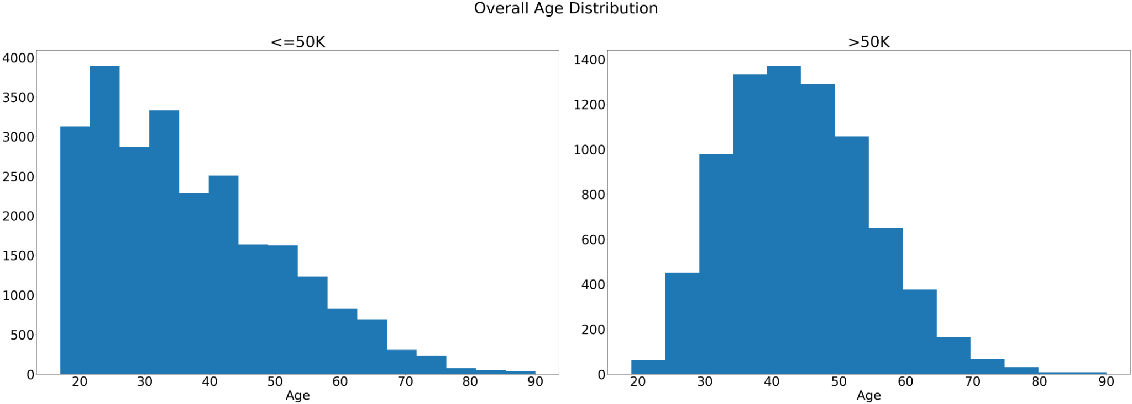
Analysis By Age
Analysis:
The distribution of the age variable for the marketing data is shown here for the groups
Outcomes:
The two class labels have a clearly different distribution. The lower income class has a right skewed distribution with more younger people and the higher income class has more of an older population.

Slide 4
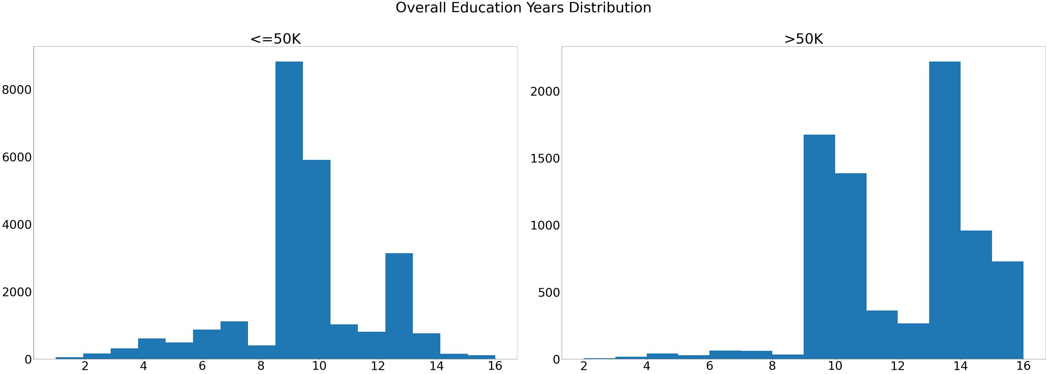
Analysis By Education Duration
Analysis:
This story again tries to contrast the amount of years of education that both class labels had.
Outcomes:
Again it became apparent from visualizing the distribution of education years that people from the higher income label were more likely to have a higher number of years of education. The median number of years of education for the lower income class was 9 while for the higher income class the median was 12.

Slide 5
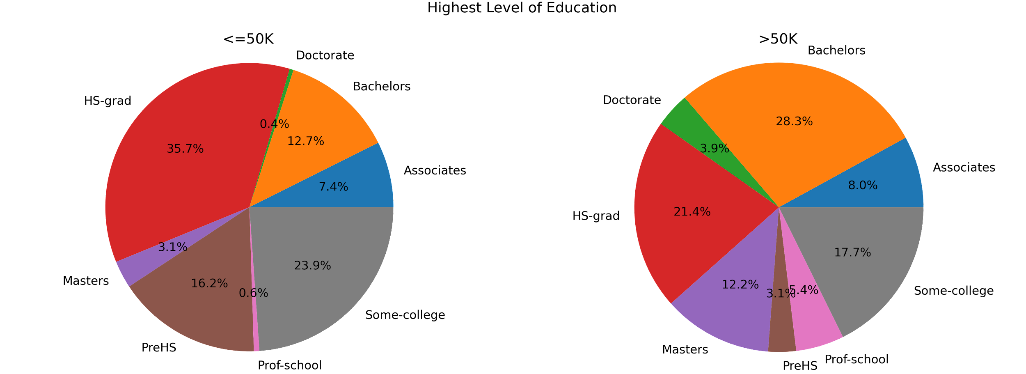
Analysis By Education Level
Analysis:
For this story, we looked at the highest degree of education held by each of the examples in the high income and low income class label.
It must be noted that we combined the labels 9th/10th/11th/12th/1st-4th/5th-6th/7th-8th/9th/ Preschool as “PreHS” and Assoc-acdm/ Assoc-voc as Associates, this was to reduce the amount of education level labels as well as aggregate the values.
Outcomes:
From this visualization it can be seen that there was a much larger proportion of people with college education among the higher income class label. Whereas the percentage of people without a high school education is larger in the lower income class.

Slide 6
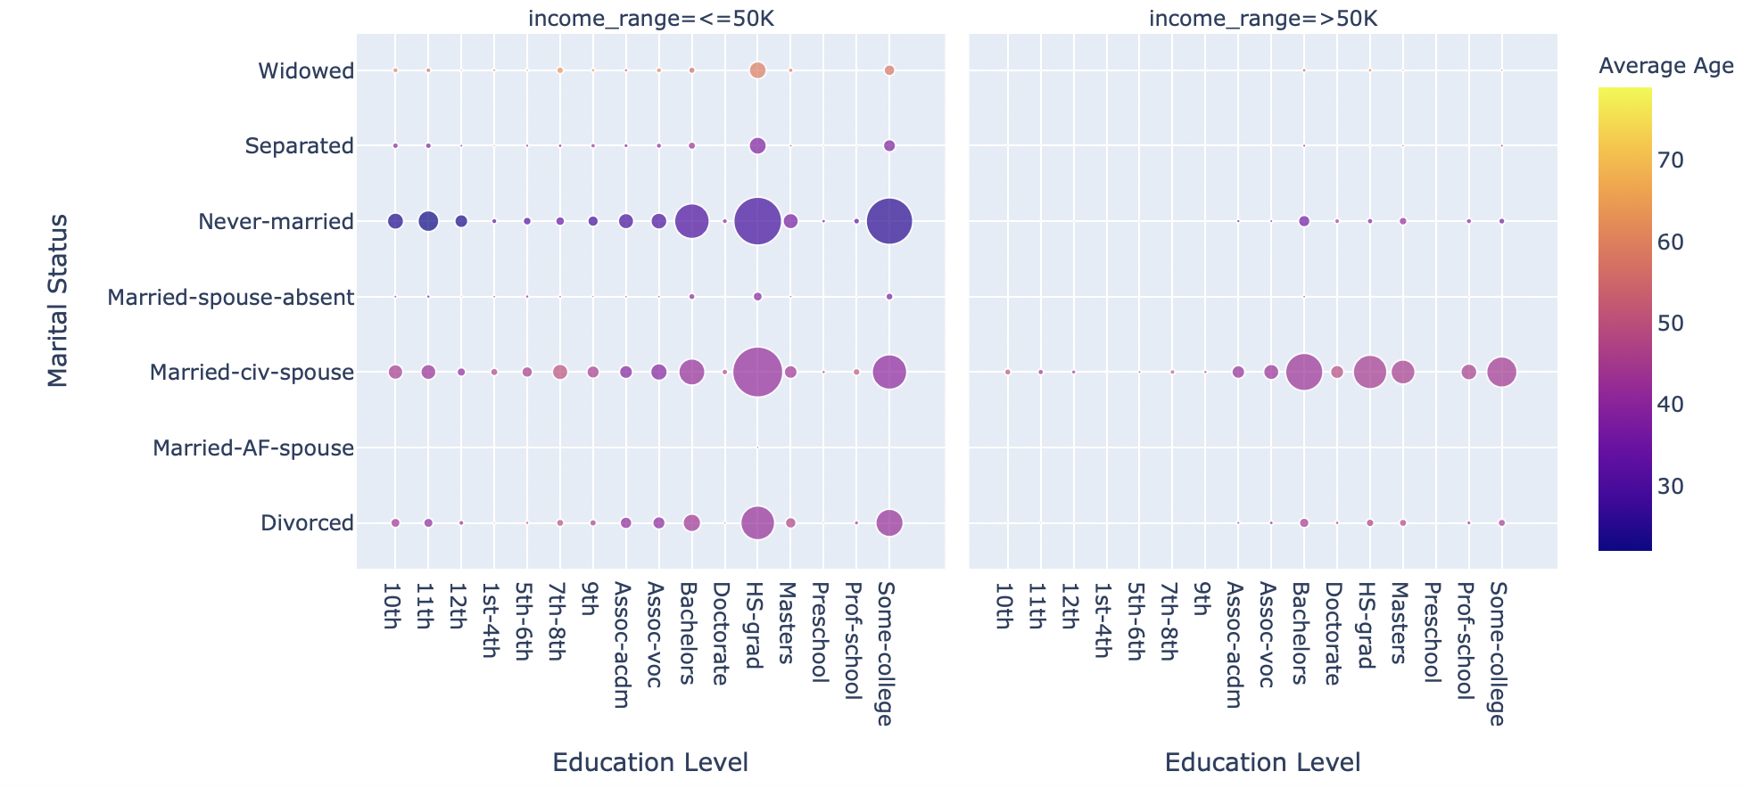
Analysis By Marital Status
Analysis:
This visualization provides an insight on
correlation between Individuals Marital status
and education level for income group <=50K
and >50K.
The visualization also provides count
for each category by hovering over the circle.
The average age sidebar with color assists on
age group to be considered while deciding
the possibility for a category to be enrolled.
Outcomes:
The visualization clearly shows that for income
level <=50K, the number of people with
“HS-grade” or “Some college” is significant
among marital status “Never Married” & “Married”
whereas in the income level >50K, the number of
“Married” individuals with “HS-grade” is more

Slide 7
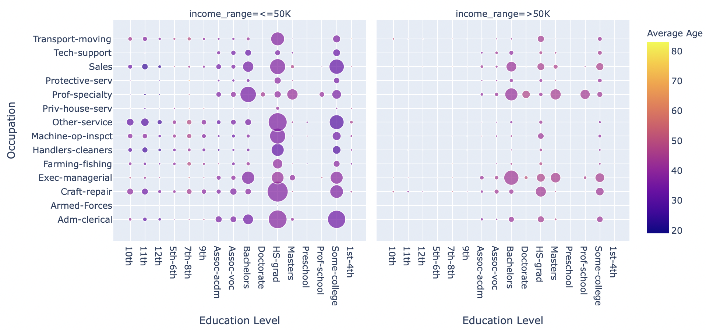
Analysis By Occupation
Analysis:
This visualization provides an insight on
correlation between Individuals occupation and
education level for income group <=50K
and >50K.
The visualization also provides count
for each category by hovering over the circle.
The average age sidebar with color assists on
age group to be considered while deciding
the possibility for a category to be enrolled.
Outcomes:
The visualization clearly shows that the
Education level “HS-Grade” & “Some-college” is
very prominent across different occupations for
<=50K income group. For income >50K,the
education level “Bachelor”,”HS-Grade” and
“Some-college” is prominent across different
occupations.

Slide 8
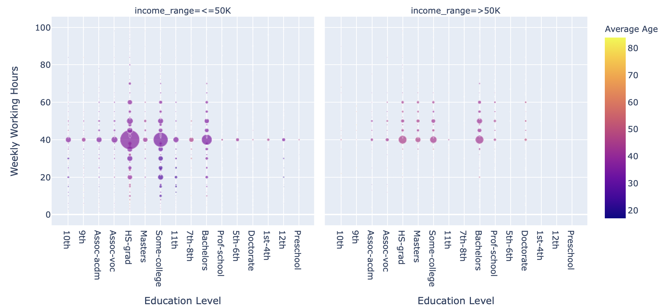
Analysis for Working Hours Per Week
Analysis:
This visualization provides an insight on
correlation between Individuals working hours per week
and education level for income group <=50K
and >50K.
The visualization also provides count
for each category by hovering over the circle.
The average age sidebar with color assists on
age group to be considered while deciding
the possibility for a category to be enrolled.
Outcomes:
The visualization clearly shows the for income
level <=50K, the population with High school and
some college level education working 40 hours
per week are good in numbers( between 100-5000).
For income level >50K, population with High school
and some college level education working between
40 to 60 hours per week are good in numbers
(between 100-1000).

Slide 9
Analysis for Occupation
User Story - Occupation
This story explores the correlation between occupation type and education level along with the average age of the individuals.With the help of scattered points,its color(representing age) and size(representing the number of individuals), it suggests which occupation type and education level to be considered for a marketing campaign.
The visualization suggests that for income level <=50K, having education level “HS-Grade” & “Some-college” the count(200-1500) is significant across different occupations whereas For income >50K,having education level ”HS-Grade” and “Some-college” the count(100-300) is not significant across occupation types.

Slide 10
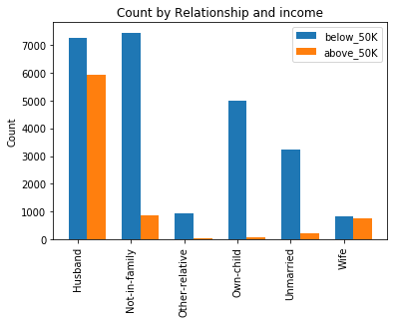
Relationship analysis
Analysis:
This visualization provides an insight on how income is affected by
relationship status. People who make more than 50K are mostly
concentrated in a single group which is “Husband”. On the other hand,
people who make less than 50K are distributed among different relationship
classes. It’s not very clear for people who make above 50K,
because our data is skewed.
Outcome:
We can ignore people who are “Husband” or “Wife”, and focus on others
because majority of them make above 50K.

Slide 11
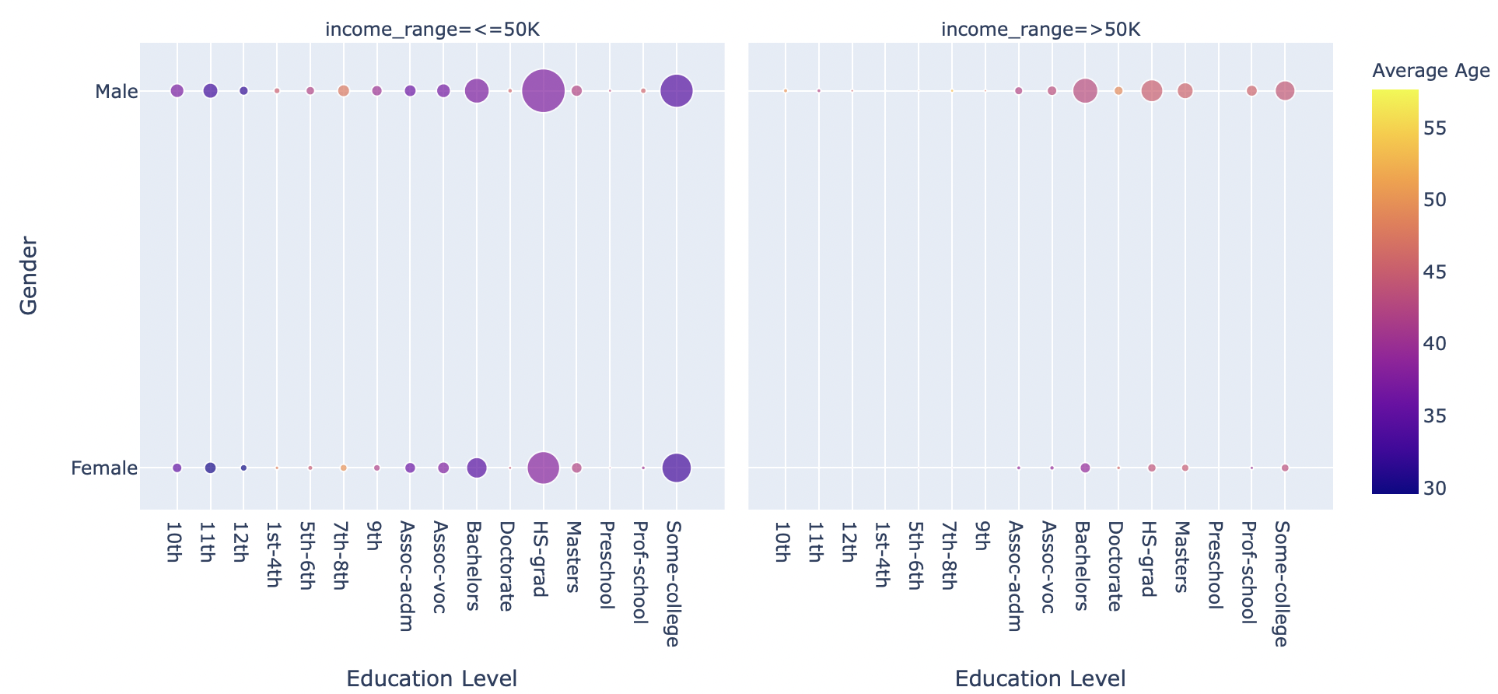
Gender Analysis
Analysis:
This visualization provides an insight on
correlation between Individuals gender and
education level for income group <=50K
and >50K.
The visualization also provides count
for each category by hovering over the circle.
The average age sidebar with color assists on
age group to be considered while deciding
the possibility for a category to be enrolled.
Outcomes:
The visualization clearly shows that the
count of male is higher than female in income
group <=50K having education level either
“HS-grade” or “Some-college” whereas in income
group >50K, only males are in the good numbers
with “HS-grade” or “Some-college” education level

Slide 12
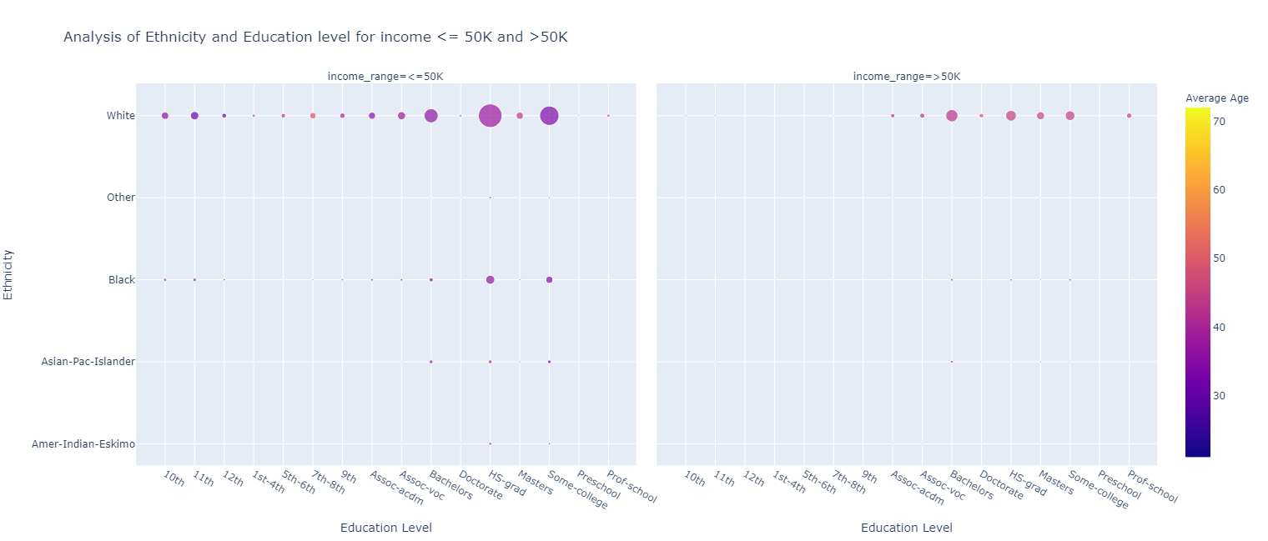
Ethnicity/Race Analysis
Analysis:
This visualization provides an insight on
correlation between Individuals ethnicity and
education level for income group <=50K
and >50K.
The visualization also provides count
for each category by hovering over the circle.
The average age sidebar with color assists on
age group to be considered while deciding
the possibility for a category to be enrolled.
Outcomes:
The visualization clearly shows that the white ethnic
Group has higher number of individuals who has
income group <=50K having education level either
“HS-grad” or “Some-college” whereas in income
group >50K, count of individuals of that ethnic group having education level “Bachelors” exceeds that of “HS-grade” or “Some-college” education level
Targeting white ethnic individuals who have education level “HS-grad” or “Some College” with income less than 50K are more likely to go for enrollment as the average age is in mid 30s.

Slide 13
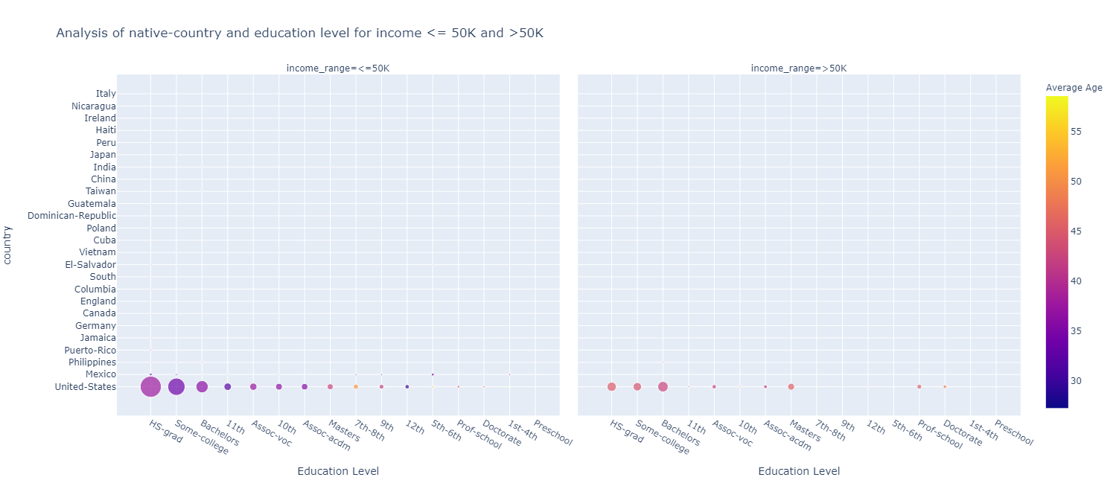
Native Country Analysis
Analysis:
This visualization provides an insight on correlation between individuals native country and education level for income group <=50K and >50K.
The visualization also provides count for each category by hovering over the circle. The average age sidebar with color assists on age group to be considered while deciding
the possibility for a category to be enrolled.
Outcomes:
The visualization clearly shows that the individuals having native country as United States is more compare to the other countries as the dataset is from United States Census Bureau. The targeted individuals for the enrollment should be individuals earning less than 50K, with education level “HS-Grad” or “Some College” or “Bachelors” as the average age is in mid 30s.

Slide 14
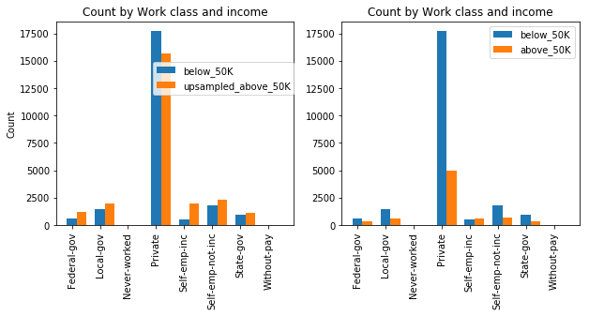
Analysis for Work Class
User Story - Work Class
Both classes have similar distribution. Therefore, it doesn’t seem like this attribute will help us differentiate between people who make above or below 50K.
Performing data augmentation makes it clear that both classes have a very similar distribution.

Slide 15
Exploration & Conclusion
vs Income Level | Plot Type | Exploration and Observation
Age group | Histogram | Median age of Lower income group is 34 years and 44 years for higher income group
Education Duration | Histogram | Lower income group could spend in avg 9 to 12 years to move to higher income group
Education Level | Pie Chart | College education group has a higher income level compared to high school Grads
Marital Status | Scatter Plot | Spouse, Single & Divorced with high school grads qualification in lower income group could be potential targets
Occupation | Scatter Plot | Higher education in college could lead to improvement in income level
Conclusion :
Candidates within age group of 30 to 40, having high school education or some college education having been spent below 9 to 12 years in overall education, if complete a successful higher education in college, have a very good chance at executive level to improve the income level. These segment of people could be the significant groups who might positively respond to ad campaigns making a college admission campaign a successful events.
Ethnicity, National Country, Gender and Relationship are observed to have not influenced the income level so can be ignored as factors for determining segmentation for building ad campaigns.

Slide 16
Questions?

